Slide 1
COMPUTER GRAPHICS & VISUALIZATION (18CS62) LINE AND CIRCLE DRAWING ALGORITHMS
Department of Computer Science & Engineering
VI Semester
2021-22
VARALAKSHMI B D DEPT OF CSE ACHARYA I T BANGALORE-560107

Slide 2
Line drawing algorithm
Programmer specifies (x,y) values of end pixels
Need algorithm to figure out which intermediate pixels are on line path
Pixel (x,y) values constrained to integer values
Actual computed intermediate line values may be floats
Rounding may be required. E.g. computed point
(10.48, 20.51) rounded to (10, 21)
Rounded pixel value is off actual line path (jaggy!!)
Sloped lines end up having jaggies
Vertical, horizontal lines, no jaggies

Slide 3
Line Drawing Algorithm
Line: (3,2) -> (9,6)
6
5
?
4
Which intermediate
pixels to turn on?
3
2
1
0 1 2 3 4 5 6 7 8 9 10 11 12

Slide 4
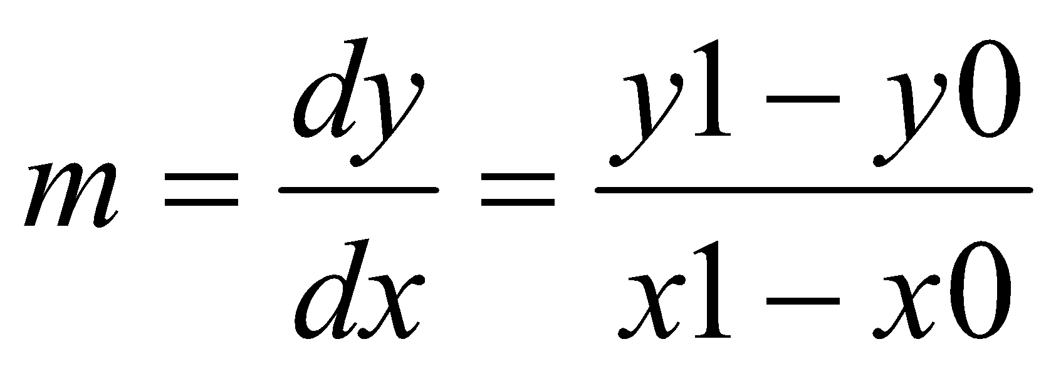
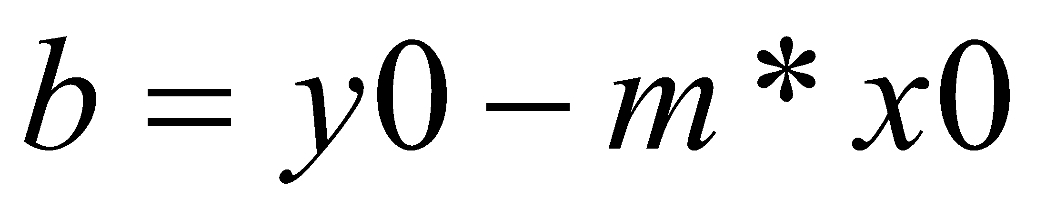
Line Drawing Algorithm
Slope-intercept line equation
y = mx + b Equation of Line where m is slope & b is intercept
Given two end points (x0,y0), (x1, y1), how to compute m and b?
(x1,y1)
dy
(x0,y0)
dx

Slide 5
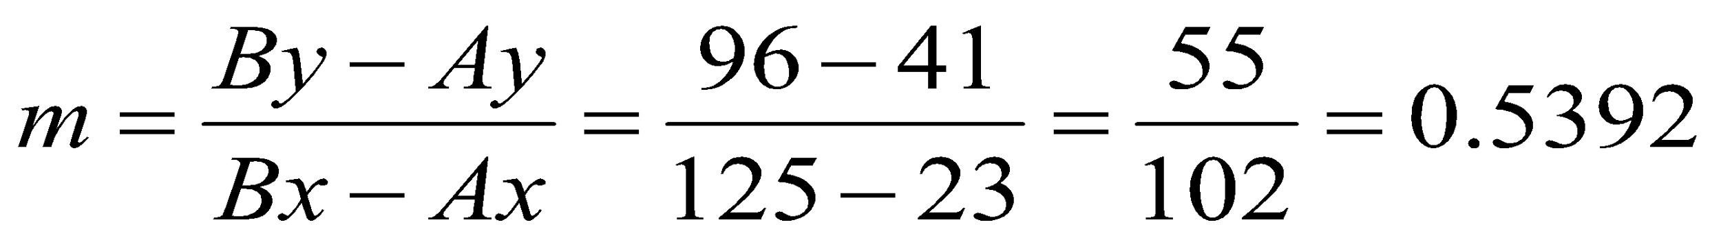
Line Drawing Algorithm
Numerical example of finding slope m:
(Ax, Ay) = (23, 41), (Bx, By) = (125, 96)

Slide 6
Digital Differential Analyzer (DDA): Line Drawing Algorithm
Walk through the line, starting at (x0,y0)
Constrain x, y increments to values in [0,1] range
Case a: x is incrementing faster (m < 1)
Step in x=1 increments, compute and round y
Case b: y is incrementing faster (m > 1)
Step in y=1 increments, compute and round x
(x1,y1)
dy
(x0,y0)
dx

Slide 7
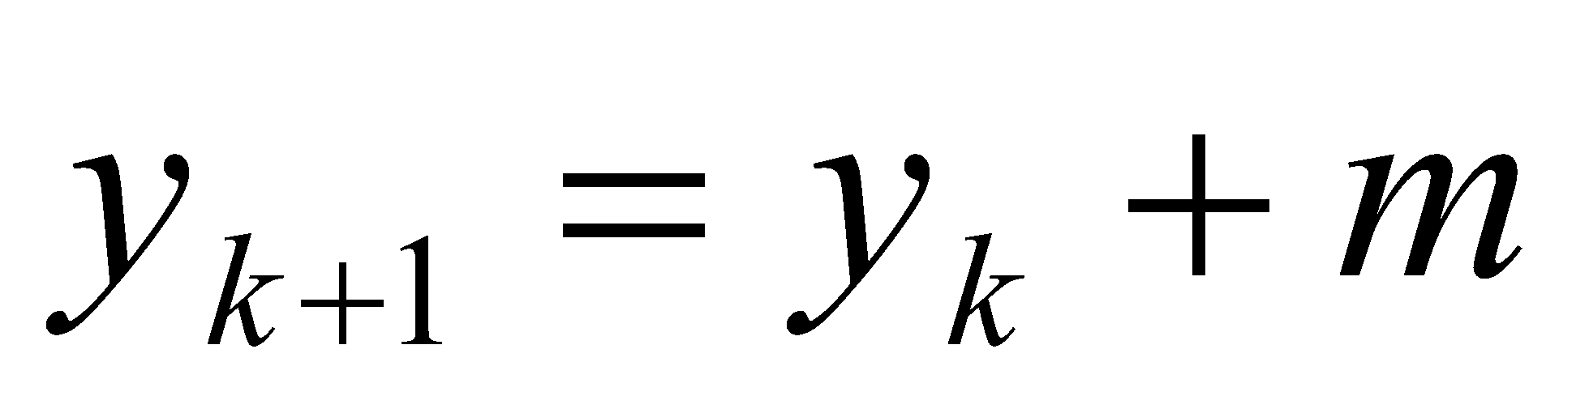
DDA Line Drawing Algorithm (Case a: m < 1)
x = x0 y = y0
Illuminate pixel (x, round(y))
(x1,y1)
x = x0 + 1
y = y0 + 1 * m
Illuminate pixel (x, round(y))
x = x + 1
y = y + 1 * m
Illuminate pixel (x, round(y))
…
Until x == x1
(x0, y0)

Slide 8
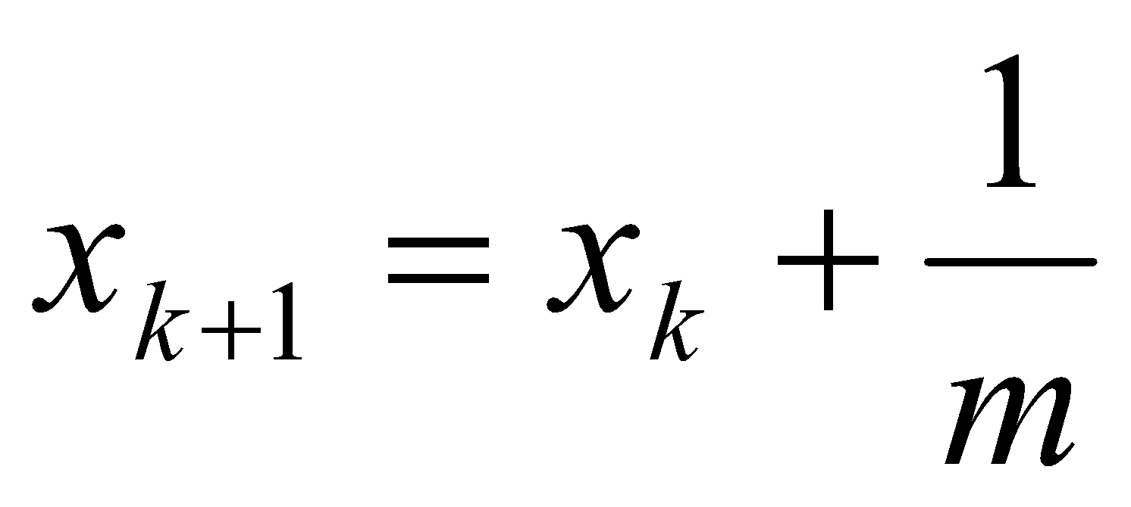
DDA Line Drawing Algorithm (Case b: m > 1)
x = x0 y = y0
(x1,y1)
Illuminate pixel (round(x), y)
y = y0 + 1
x = x0 + 1 * 1/m
Illuminate pixel (round(x), y)
y = y + 1
x = x + 1 /m
Illuminate pixel (round(x), y)
…
(x0,y0)
Until y == y1

Slide 9
DDA Line Drawing Algorithm Pseudocode
compute m;
if m < 1:
{
float y = y0; // initial value
for(int x = x0;x <= x1; x++, y += m)
setPixel(x, round(y));
}
else // m > 1
{
float x = x0; // initial value
for(int y = y0;y <= y1; y++, x += 1/m)
setPixel(round(x), y);
} Note: setPixel(x, y) writes current color into pixel in column x and row y in frame buffer

Slide 10
DDA Line Drawing Algorithm Drawbacks
DDA is the simplest line drawing algorithm
Not very efficient
Round operation is expensive
Optimized algorithms typically used.
Integer DDA
Eg. Bresenham algorithm (Hill, 10.4.1)
Bresenham algorithm
Incremental algorithm: current value uses previous value
Integers only: avoid floating point arithmetic
Several versions of algorithm: we’ll describe midpoint version of algorithm

Slide 11
Step-01:
Calculate ΔX, ΔY and M from the given input.
These parameters are calculated as-
ΔX = X_{n} – X₀
ΔY =Y_{n} – Y₀
M = ΔY / ΔX

Slide 12
Step-02:
Find the number of steps or points in between the starting and ending coordinates.
if (absolute (ΔX) > absolute (ΔY))
Steps = absolute (ΔX);
else
Steps = absolute (ΔY);

Slide 13
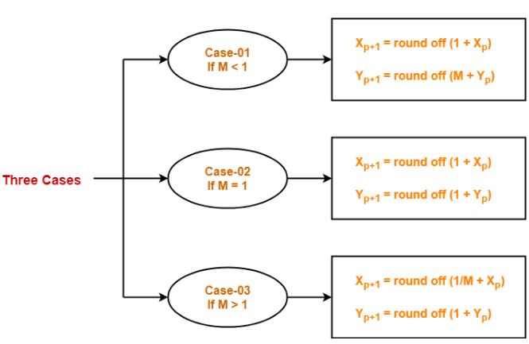
Step-03:
Suppose the current point is (X_{p}, Y_{p}) and the next point is (X_{p+1}, Y_{p+1}).
Find the next point by following the below three cases-

Slide 14
Step-04:
Keep repeating Step-03 until the end point is reached or the number of generated new points (including the starting and ending points) equals to the steps count.

Slide 15
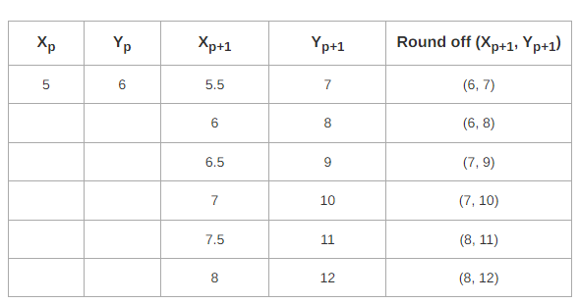
Problem-01: Calculate the points between the starting point (5, 6) and ending point (8, 12).

Slide 16
Advantages of DDA
It calculates the pixel positions faster than the calculations performed by using the equation y=mx +b.
Multiplication is eliminated as the x and y increments are used to determine the position of the next pixel on a line

Slide 17
Disadvantages of DDA
The rounding and floating point operations are time consuming.
The round-off error which results in each successive addition leads to the drift in pixel position, already calculated

Slide 18
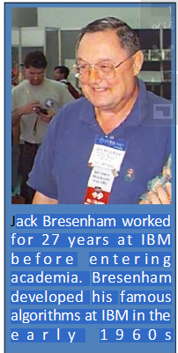

Bresenham's line algorithm

Slide 19
Bresenham’s Line-Drawing Algorithm
Accurate and efficient
Uses only incremental integer calculations
The method is described for a line segment with a positive slope less than one
The method generalizes to line segments of other slopes by considering the symmetry between the various octants and quadrants of the xy plane

Slide 20
The Problem (cont…)
What happens when we try to draw this on a pixel based display?
How do we choose which pixels to turn on?

Slide 21
Bresenham’s Line-Drawing Algorithm
Decide what is the next pixel position
(11,11) or (11,12)
13
Specified
line path
12
11
10
10
11
12
13

Slide 22
Bresenham’s Line-Drawing Algorithm
y_{k+3}
For the pixel position x_{k+1}=x_{k}+1, which one we should choose:
(x_{k+1},y_{k}) or (x_{k+1}, y_{k+1})
y_{k+2}
y=mx+b
y_{k+1}
y_{k}
x_{k}
x_{k+1}
x_{k+2}
x_{k+3}

Slide 23
Bresenham’s Approach
y=m(x_{k} + 1)+b
d_{lower}=y-y_{k}
=m(x_{k} + 1)+b-y_{k}
d_{upper}=(y_{k}+1)-y
= y_{k}+1 -m(x_{k} + 1)-b
y_{k+1}
d_{upper}
y
d_{lower}
y_{k}
x_{k+1}
d_{lower}- d_{upper}= 2m(x_{k} + 1)-2y_{k}+2b-1
Rearrange it to have integer calculations:
m=Δy/Δx
Decision parameter: p_{k}= Δx(d_{lower}- d_{upper})=2Δy.x_{k} - 2Δx. y_{k} +
c

Slide 24
The Decision Parameter
Decision parameter: p_{k}= Δx(d_{lower}- d_{upper})=2Δy.x_{k} - 2Δx. y_{k} + c
p_{k} has the same sign with d_{lower}- d_{upper} since Δx>0.
c is constant and has the value c= 2Δy + Δx(2b-1)
c is independent of the pixel positions and is eliminated from decision parameter p_{k}.
If d_{lower}< d_{upper} then p_{k} is negative.
Plot the lower pixel (East)
Otherwise
Plot the upper pixel (North East)

Slide 25
Successive decision parameter
At step k+1
p_{k+1}= 2Δy.x_{k+1} - 2Δx. y_{k+1} + c
Subtracting two subsequent decision parameters yields:
p_{k+1}-p_{k}= 2Δy.(x_{k+1}-x_{k}) - 2Δx. (y_{k+1}-y_{k})
x_{k+1}=x_{k}+1 so
p_{k+1}= p_{k} + 2Δy - 2Δx. (y_{k+1}-y_{k})
y_{k+1}-y_{k} is either 0 or 1 depending on the sign of p_{k}
First parameter p₀
p₀=2 Δy - Δx

Slide 26
Bresenham's Line-Drawing Algorithm for |m| < 1
Input the two line endpoints and store the left endpoint in (x₀ ,y₀).
Load (x₀ ,y₀) into the frame buffer; that is, plot the first point.
Calculate constants Δx, Δy, 2Δy, and 2Δy - 2Δx, and obtain the starting value for the decision parameter as
p₀=2 Δy - Δx
4. At each x_{k} along the line, starting at k = 0, perform the following test:
If p_{k} < 0, the next point to plot is (x_{k+1}, y_{k}) and
p_{k+1}=p_{k} + 2Δy
Otherwise, the next point to plot is (x_{k+1}, y_{k+1}) and
p_{k+1}=p_{k} + 2Δy - 2Δx
5. Repeat step 4 Δx -1 times.

Slide 27

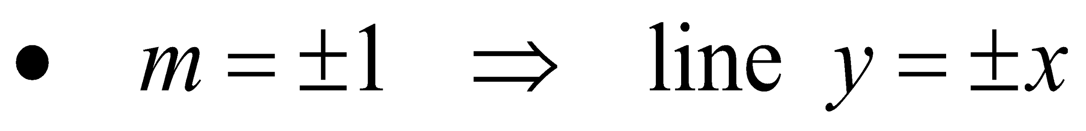

Trivial Situations: Do not need Bresenham

Slide 28
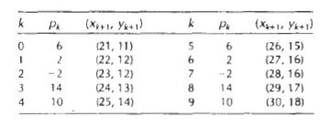
Example
Draw the line with endpoints (20,10) and (30, 18).
Δx=30-20=10, Δy=18-10=8,
p₀ = 2Δy – Δx=16-10=6
2Δy=16, and 2Δy - 2Δx=-4
Plot the initial position at (20,10), then

Slide 29
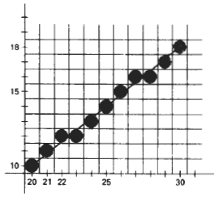
Example

Slide 30
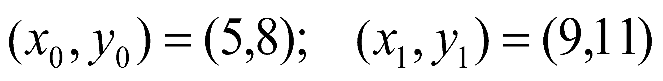
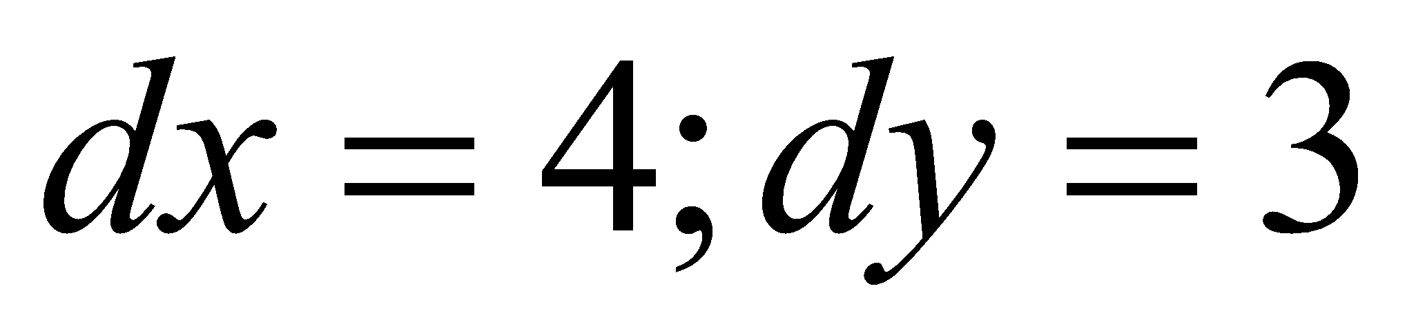
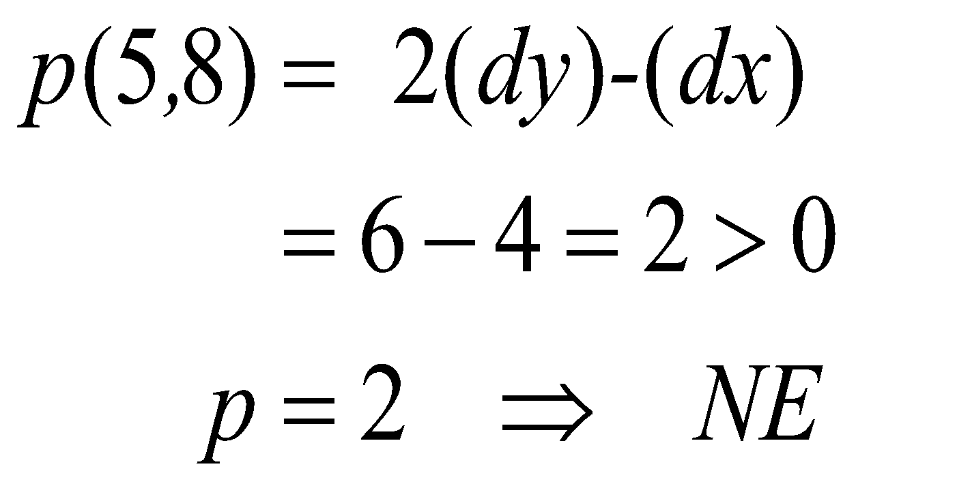
Example
Line end points:
Deltas:
initially

Slide 31
Pseudocode
/* Bresenham line-drawing procedure for |m| < 1.0. */
void lineBres (int x0, int y0, int xEnd, int yEnd)
{
int dx = fabs (xEnd - x0), dy = fabs(yEnd - y0);
int x, y, p = 2 * dy - dx;
int twoDy = 2 * dy, twoDyMinusDx = 2 * (dy - dx);
/* Determine which endpoint to use as start position. */
if (x0 > xEnd) {
x = xEnd; y = yEnd; xEnd = x0;
}
else {
x = x0; y = y0;
}
setPixel (x, y);

Slide 32
Pseudocode
while (x < xEnd) {
x++;
if (p < 0)
p += twoDy;
else {
y++;
p += twoDyMinusDx;
}
setPixel (x, y);
}
}

Slide 33
In Bresenham’s line drawing algorithm the incremental integer calculations are used to scan convert the lines, so that, the circles and the other curves can be displayed.
?
?
?
?

Slide 34
(3,3)
?
?
?
?
(2,2)
(3,2)
.The next sample positions can be plotted either at (3,2) or (3,3) ?

Slide 35
For lines with positive slope m<1
The pixel positions on line can be identified by doing sampling at unit x intervals.
The process of sampling begins from the pixel position (X0,Y0) and proceeds by plotting the pixels whose ‘Y’ value is nearest to the line path.
If the pixel to be displayed occurs at a position (X_{k}, Y_{k}) then the next pixel is either at (X_{k}+1,Y_{k}) or (X_{k}+1,Y_{k}+1) i.e, (3,2) or (3,3)
The ‘Y’ coordinate at the pixel position Xk+1 can be obtained from
Y=m(X_{k}+1)+b . . . . . . . . . . ……. eq 1

Slide 36
the separation between (X_{k+1},Y_{k}) and (X_{k+1},Y) is d1 and the separation between (X_{k+1},Y) and (X_{k+1}, Y_{k+1}) is d2 then
d1 = y – y_{k} and
d2 = (Y_{k}+1) – Y
(X_{k}, y_{k}+1)
(X_{k}+1, y_{k}+1)
.
d₂
P₀
d₁
(X_{k}, y_{k})
(X_{k}+1,y_{k})

Slide 37
Y=m(X_{k}+1)+b . . . . . . . ……. eq 1
d1=y – y_{k}
d1=m(x_{k}+1)+b – Y_{k} ( from eqn (1) …..( 2)
And d2= (Y_{k}+1) – Y
=(Y_{K}+1) – [m(X_{k}+1)+b]
=(Y_{K}+1) – m(X_{k}+1) – b …….(3)
The difference is given as
d1-d2 =
= m(X_{k}+1)+b-Y_{k}-[(Y_{k}+1)-m(X_{k}+1)-b]
=m(X_{k}+1)+b-Y_{k}-(Y_{k}+1)+m(X_{k}+1)+b
d1-d2 = 2m(X_{k}+1)-2Y_{k}+2b – 1 ………(4)

Slide 38
Contd..
A decision parameter P_{k} can be obtained by substituting m= dy/dx in equation 4
d1 – d2 = 2m(X_{k}+1)-2Y_{k}+2b – 1
= 2 dy/dx (X_{k}+1) – 2Y_{k} + 2b – 1
= 2 dy(X_{k}+1)-2 dx.Y_{k} + 2b.dx -dx
dx
dx(d1-d2) = 2 dy(X_{k}+1)-2 dx.Y_{k} + 2b.dx - dx
₌ 2 dyX_{k}+2 dy-2 dx.Y_{k} + 2b.dx -dx
₌ 2 dyX_{k}- 2 dx.Y_{k} + c
Where, dx(d1-d2) = Pk and
c= 2 dy+ dx(2b-1)
Pk = 2 dyX_{k}- 2 dx.Y_{k} + c . . . . . . . . . . . . . . . . . . . … …(5 )
The value of c is constant and is independent of the pixel position. It can be deleted in the recursive calculations, of for P_{k}
if d1 < d2 (i.e, Yk is nearer to the line path than Yk+1) then, P_{k} is negative.
If Pk is –ve, a lower pixel (Y_{k})is plotted else, an upper pixel (Y_{k}+1)is plotted.
At k+1 step, the value of Pk is given as
P_{K+1} = 2 dyX_{k+1}- 2 dx.Y_{k+1} + c …………………………………..(6 ) (from 5)

Slide 39
M
Eq 6 – eq 5
Pk+1 – Pk = (2 dyX_{k+1}- 2 dx.Y_{k+1} + c ) - (2 dyX_{k}+2 dx.Y_{k} + c)
= 2dy(X_{k+1}-X_{k} ) – 2 dx(Y_{k+1} – Y_{k} ) ………….(7)
Since X_{k+1} = X_{k} +1 The eqn 7 becomes
Pk+1 – Pk = 2dy(X_{k} +1 -X_{k} ) – 2 dx(Y_{k+1} – Y_{k} )
= 2dy - 2 dx(Y_{k+1} – Y_{k} )
Pk+1 = Pk + 2dy - 2 dx(Y_{k+1} – Y_{k} ) ………………..( 8)
Where (Yk+1 – Yk) is either 0 or 1 based on the sign of Pk.
The starting parameter P0 at the pixel position (X0,Y0) is given as
P0 = 2dy – dx ………………………(9)

Slide 40
y=mx+c is the eq of line
In col 2 the line is passing through x₀+1 so the y value is given by
y=m(x₀+1)+c (green dot)
Now we need to find out the values of d1 and d2
d1= y-y₀
d2=(y₀+1)-y
d1=m(x₀+1) – y₀ and d2= (y0+1) - m(x₀+1)
d1-d2=[mx₀+m – y₀] - [(y₀+1) - mx₀-m]
=mx₀+m – y₀ - y₀-1 + mx₀+m
= 2mx₀+2m –2y₀-1
= 2mx₀+2m –2mx₀-1 (y=mx+c passes thr (x0, y0) so we can say y₀=mx₀+c)
d1-d2 = 2mx₀+2m –2mx₀-1
d1-d2=2m-1 ( m= ∆y / ∆x)
d1-d2 = 2∆y/ ∆x - 1
P₀= 2∆y - ∆x
Col 1 Col 2
(X₀, y₀+1)
(X₀+1, y₀+1)
d₂
P₀
d₁
(X₀, y₀)
(X₀+1,y₀)
∆x(d1-d2) = 2∆y - ∆x
∆x(d1-d2) = 2∆y - ∆x

Slide 41
Bresenham’s algorithm
Step 1: Enter the 2 end points for a line and store the left end point in (X0,Y0).
Step 2: Plot the first point be loading (X0,Y0) in the frame buffer.
Setp 3: determine the initial value of the decision parameter by calculating the constants dx, dy, 2dy and 2dy-2dx as
P0 = 2dy –dx
Step 4: for each Xk, conduct the following test, starting from k= 0
If Pk <0, then the next point to be plotted is at (Xk+1, Yk) and
Pk+1 = Pk + 2dy
Else, the next point is (Xk+1, Yk+1) and
Pk+1 = Pk + 2dy –2dx (step 3)
Step 5: iterate through step (4) dx times.

Slide 42
Example
Let the given end points for the line be (30,20) and (40, 28)
M = dy = y2 – y1 = 28 – 20 = 8
dx x2 – x1 40 – 30 = 10
m = 0.8
dy = 8 and dx = 10
The initial decision parameter P0 is
P0 = 2dy – dx = 2(8) – 10 = 16 – 10 = 6
P0 = 6
The constants 2dy and 2dy-2dx are
2dy = 2(8) = 16 2dy-2dx = 2(8)- 2(10) =16 – = 20
2dy = 16 2dy – 2dx = - 4

Slide 43
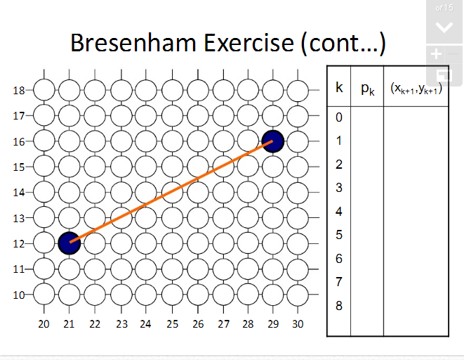

Slide 44
The starting point (x0, y0)=(30,20) and the successive pixel positions are given in the following table
K | P_{k} | (X_{k+1}, Y_{k+1})
0 | 6 | (31,21)
1 | 2 | (32,22
2 | -2 | 33,22
3 | 14 | 34,23
4 | 10 | 35,24
5 | 6 | 36,25
6 | 2 | 37,26
7 | -2 | 38,26
8 | 14 | 39,27
9 | 10 | 40,28

Slide 45
End points (30,20) (40,28)
dx=x2-x1=40-30=10 dy= y2-y1=28-20=8
P0=2dy-dx=2X8-10 = 6 >0 pt(31,21)
Pk+1= pk+2dy-2dx= 6+16-20 =2 >0 (32,22)
Pk+1=2+16-20 =-2 <0 (33,22)
Pk+1= pk+2dy =-2+16 = 14 >0 (34,23)
Pk+1= pk+2dy-2dx=14+16-20=10>0 (35,24)
Pk+1=10+16-20=6 >0 (36,25)
Pk+1= 6+16-20=2>0 (37,26)
Pk+1=2+16-20=-2 <0 (38,26)
Pk+1= pk+2dy=-2+16=14>0 (39,27)
Pk+1=pk+2dy-2dx= 14+16-20=10>0 (40,28)

Slide 46
In bresenham’s algorithm, if the positive slope of a line is greater than 1, the roles of x and y are interchanged.
For positive slope lines:
If the initial position of a line is the right end point, then both x and y are decremented as we move from right to left.
If d1 = d2 then always select the upper or the lowet candidate pixel.
For negative slope lines:
One coordinate increases and the other coordinate decreases.
Special cases:
the vertical lines dx = 0, horizontal lines dy = 0 and diagonal lines |dx| = |dy| can be directly loaded into the frame buffer.

Slide 47
Positive slope less than one

Slide 48
Void LineBres( int x1, int y1, int x2, int y2)
{
int dx =abs(x2-x1), dy= abs(y2-y1)
int p=2* dy- dx ;
int x, y, Xend; // Xends is similar to steps in DDA
If(x1>x2)
{
x=x2;y=y2;Xend=x1;
}
else
{
x=x1;y=y1;Xend=x2;
}
setPexel( x, y );
While( x < Xend)
{
x++;
if( p < 0)
p=p+2dy;
else
{
y++;
p=p+2dy-2dx;
}
setPixel(x,y);
} // End While
} //End LineBres

Slide 49
Advantages of Bresenham’s Alg.
It uses only integer calculations
So, it is faster than DDA

Slide 50
SOLVE
Calculate the points between the starting coordinates (9, 18) and ending coordinates (14, 22).
Calculate the points between the starting coordinates (40, 20) and ending coordinates (50, 30).

Slide 51
COMPUTER GRAPHICS & VISUALIZATION (18CS62) MIDPOINT CIRCLE DRAWING ALGORITHMS
Department of Computer Science & Engineering
VI Semester
2021-22
VARALAKSHMI B D DEPT OF CSE ACHARYA I T BANGALORE-560107

Slide 52
Midpoint Circle Algorithm
As in the raster line algorithm, we sample at unit intervals and determine the closest pixel position to the specified circle path at each step.
For a given radius r and screen center position (xc , yc ), we can first set up our algorithm to calculate pixel positions around a circle path centered at the coordinate origin (0, 0)
Then each calculated position (x, y) is moved to its proper screen position by adding xc to x and yc to y
Along the circle section from x = 0 to x = y in the first quadrant, the slope of the curve varies from 0 to −1.0.

Slide 53
Midpoint Circle Algorithm
To apply the midpoint method, we define a circle function as
fcirc(x, y) = x2 + y2 − r 2----------(1)
fcirc(x, y) < 0, if (x, y) is inside the circle boundary
fcirc(x, y) = 0, if (x, y) is on the circle boundary
fcirc(x, y) > 0, if (x, y) is outside the circle boundary

Slide 54
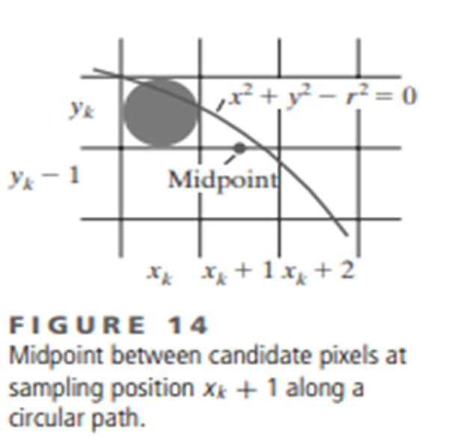
Midpoint Circle Algorithm
Figure 14 shows the midpoint between the two candidate pixels at sampling position xk + 1.
Assuming that we have just plotted the pixel at (xk , yk ), we next need to determine whether the pixel at position (xk + 1, yk ) or the one at position
(xk + 1, yk − 1) is closer to the circle.
Our decision parameter is the circle function 1 evaluated at the midpoint between these two pixels:

Slide 55

Midpoint Circle Algorithm

Slide 56
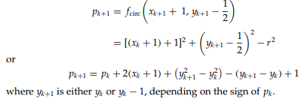
Midpoint Circle Algorithm
Successive decision parameters are obtained using incremental calculations. We obtain a recursive expression for the next decision parameter by evaluating the circle function at sampling position xk+1 + 1 = xk + 2:

Slide 57
Midpoint Circle Algorithm
Increments for obtaining pk+1 are either 2xk+1 +1 (if pk is negative) or 2xk+1 + 1−2yk+1.
Evaluation of the terms 2xk+1 and 2yk+1 can also be done incrementally as 2xk+1 = 2xk + 2
2yk+1 = 2yk − 2
At the start position (0, r), these two terms have the values 0 and 2r, respectively.
Each successive value for the 2xk+1 term is obtained by adding 2 to the previous value, and each successive value for the 2yk+1 term is obtained by subtracting 2 from the previous value.

Slide 58
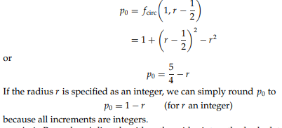
Midpoint Circle Algorithm
The initial decision parameter is obtained by evaluating the circle function at the start position (x0, y0) = (0, r)

Slide 59
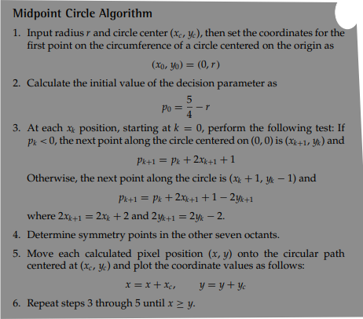

Slide 60
Midpoint Circle Algorithm
Given a circle radius r = 10, we demonstrate the midpoint circle algorithm by determining positions along the circle octant in the first quadrant from
x = 0 to x = y.
The initial value of the decision parameter is p0 = 1 − r = −9
For the circle centered on the coordinate origin, the initial point is (x0, y0) = (0, 10),
and initial increment terms for calculating the decision parameters are
2x0 = 0, 2y0 = 20

Slide 61
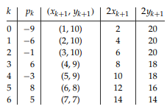
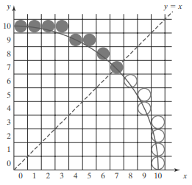
Successive midpoint decision parameter values and the corresponding coordinate positions along the circle path are listed in the following table:
A plot of the generated pixel positions in the first quadrant is shown here.

